Slide 1
Mini Project Review
Iterative Text-to-Image conversion using Recurrent Adversarial Models.
B.Tech CSE, 2016 - 2020 Batch

Slide 2
Team
Vinay Varma Nadimpalli AM.EN.U4CSE16505
Venu Vardhan Reddy Tekula AM.EN.U4CSE16508
Sedimbi Satya Pramod AM.EN.U4CSE16255
Sumanth Javvaji AM.EN.U4CS16129

Slide 3
Project Guide
Dr. Jyothisha J. Nair
Vice Chairperson, Computer Science, School of Engineering, Amritapuri.
Associate Professor, Computer Science, School of Engineering, Amritapuri.

Slide 4
Problem Definition
There are people who are deaf, mentally challenged, and suffering from dyslexia. Visual representation of data, information or statistics will make comprehension easier for people with such disorders.
Existing models which can convert text to images aren’t interactive and we aim to build a model which can iteratively generate Images based on continuous linguistic input.

Slide 5
Related Work
A lot of research across the world has been conducted to build a model that takes user input as text, interprets it and then converts that information from the text embeddings space to 2-D image space where the image will closely resemble what the input text describes.
One potential area which is yet to be explored is the iterative generation of images from continuous linguistic inputs.

Slide 6
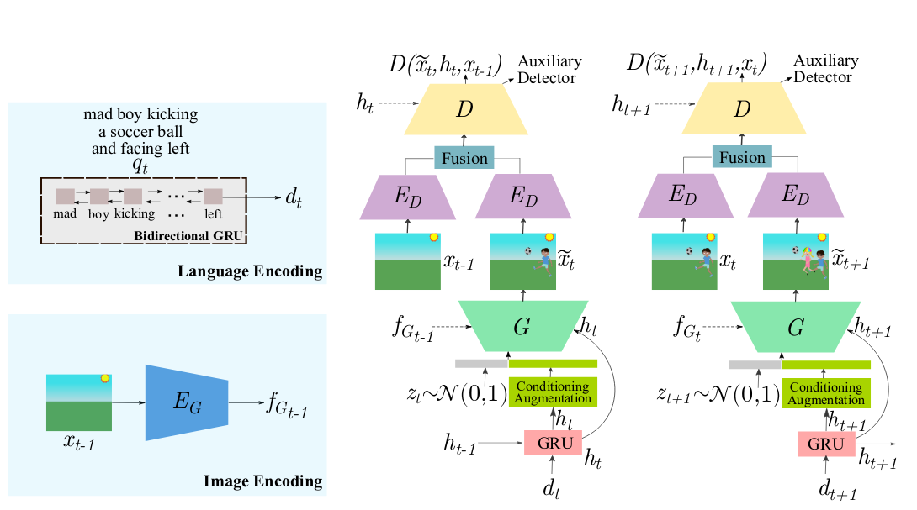
Proposed Model

Slide 7
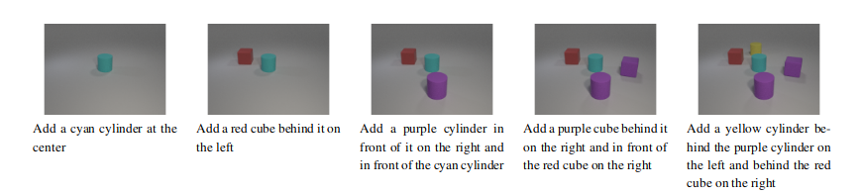
Sample of i-CLEVER dataset
Each sample is a consecutive sequence of image-label pairs with each image-label pair directly dependent on the previous image-label pairs.

Slide 8
Data Preparation
The dataset is in three different folders images, scenes and text files.
The Scene JSON files contain the information about each image in with details of all the objects present with their relative positions and exact locations in the images.
We also have a background image which is a blank image.

Slide 9
Data Preparation
We generate a objects.txt file from the initial vocabulary we have.
We make use of these objects.txt, images, scene json files and text files to convert them into structured HDF5 files.

Slide 10
Image Encoder class
We build an Image Encoder class with two blocks - ResUp block and ResDown block.
ResDown block takes in a input image extracts the features from it.
ResUp block takes in vectors which represent the image and convert it into a full size image.

Slide 11
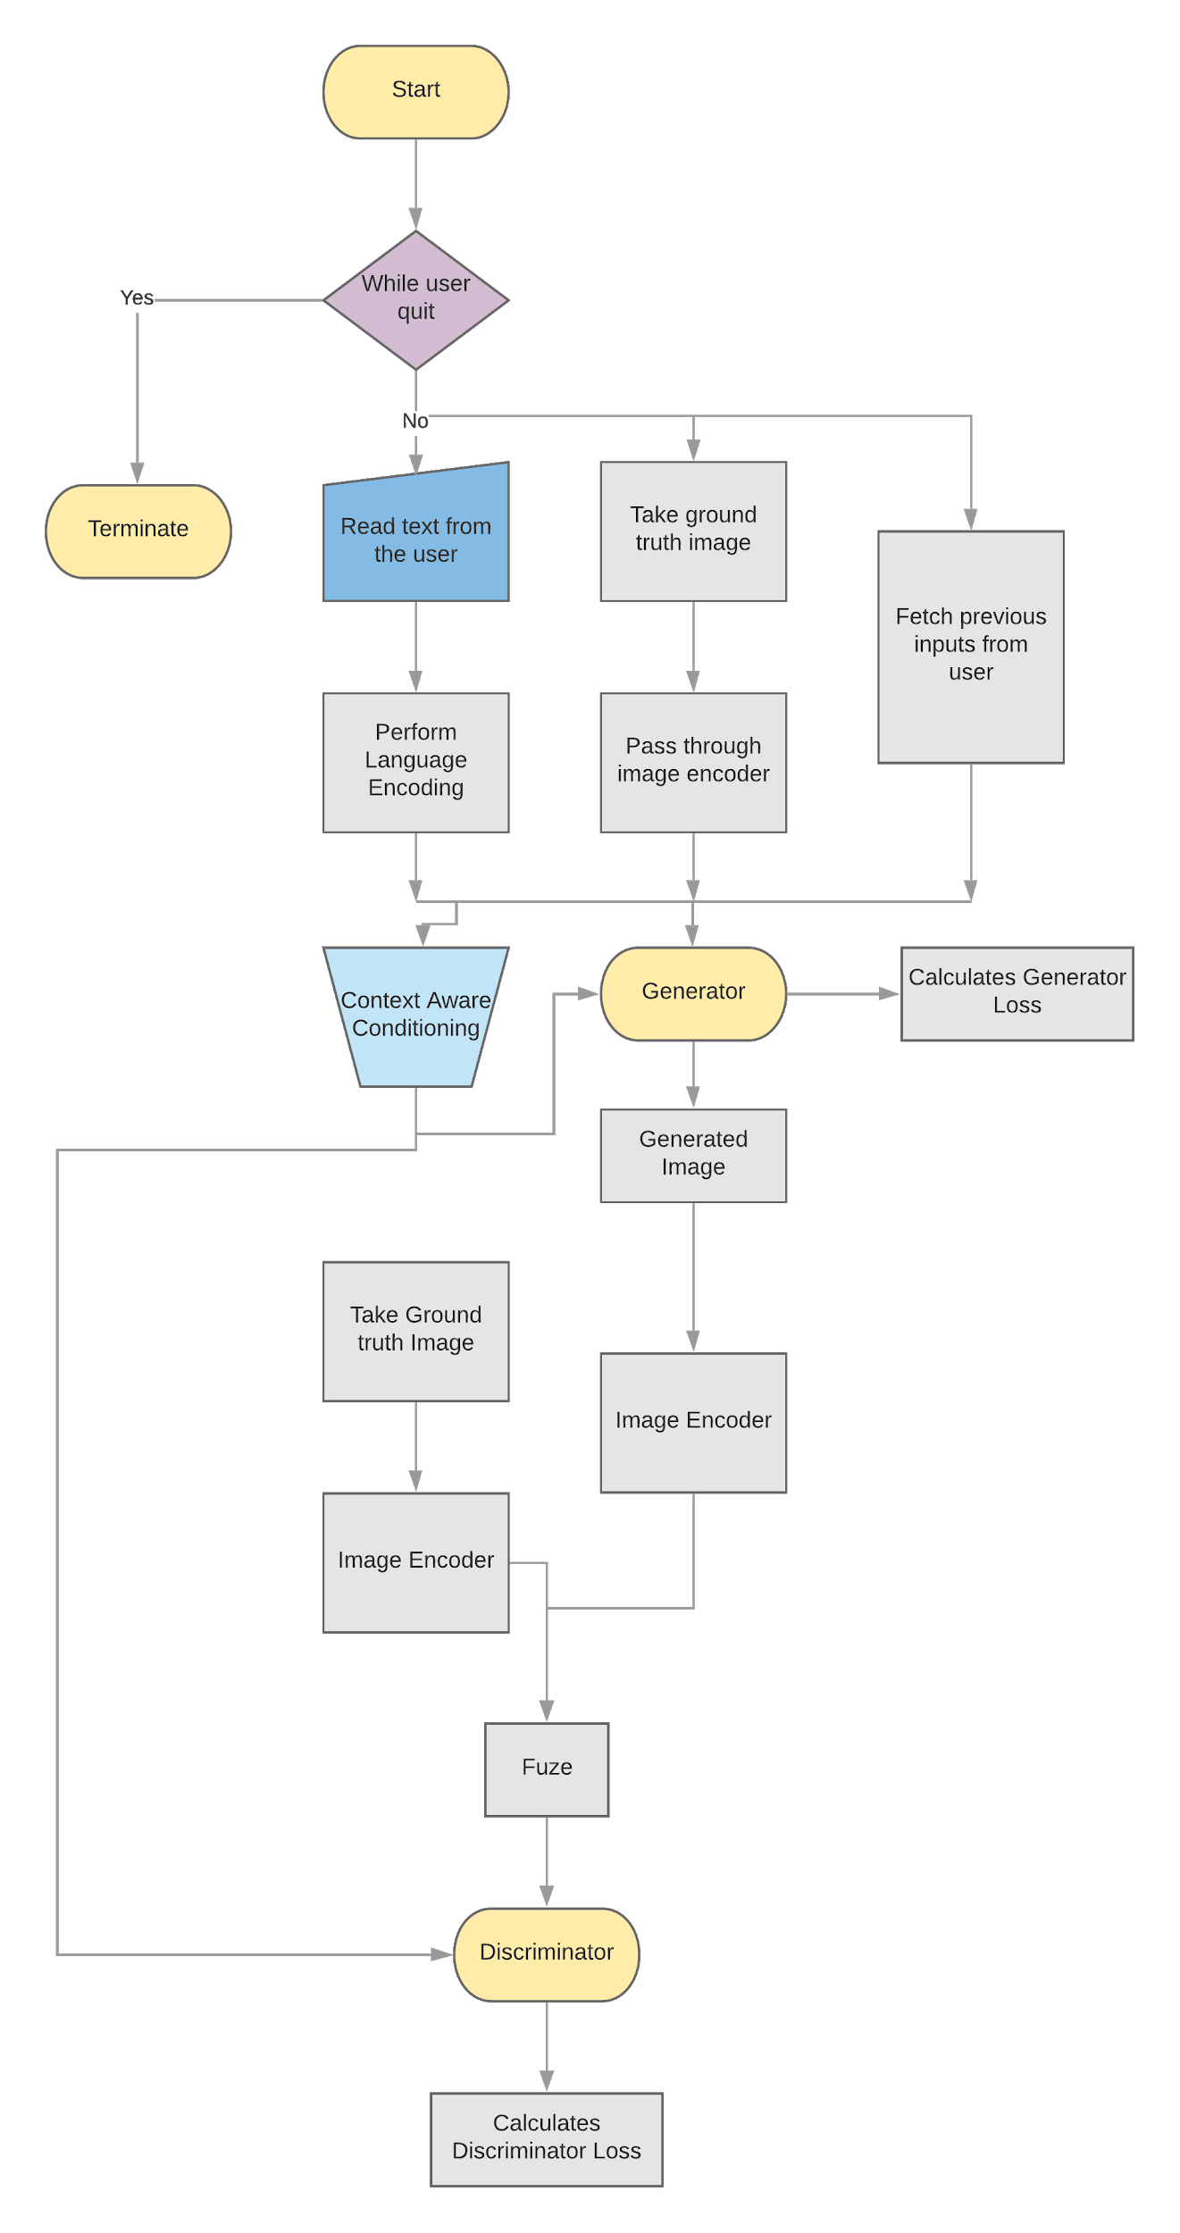
Data Flow during Training Phase

Slide 12
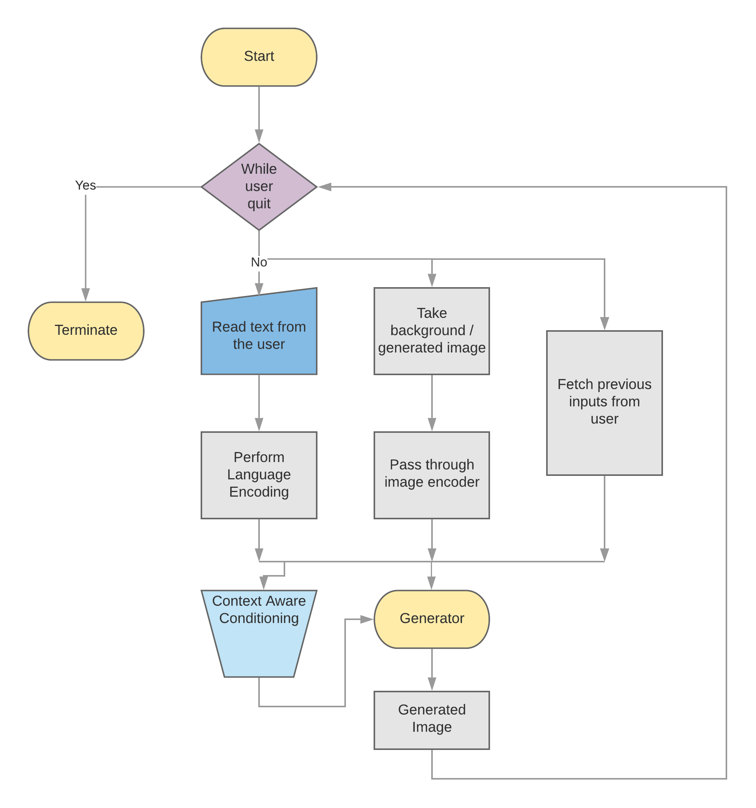
Data Flow during Inference Phase

Slide 13
References
Generative Neural Visual Artist (GeNeVA)
Ian Goodfellow, Jean Pouget-Abadie, Mehdi Mirza,Bing Xu, David Warde-Farley, Sherjil Ozair, AaronCourville, and Yoshua Bengio, “Generative adversarial nets”
Mehdi Mirza and Simon Osindero, “Conditional generative adversarial nets”

